Slide 1
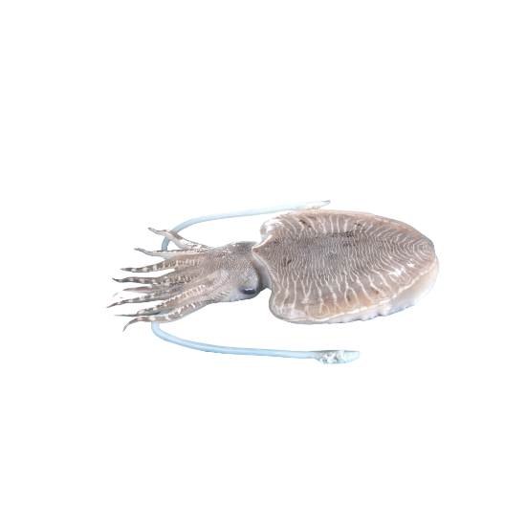
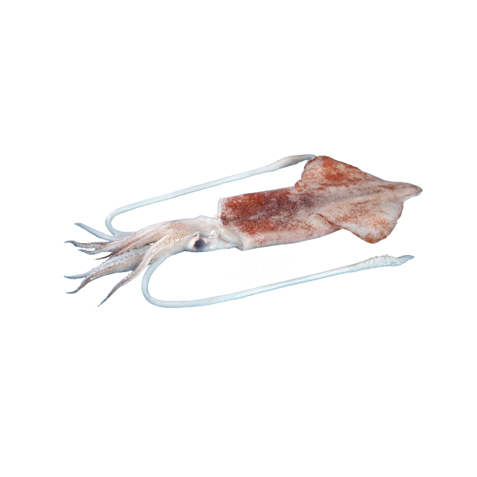
EU GSP REX CONTROL MECHANISM
TRAINING MATERIAL OF PROCEDURE FOR VERIFICATION OF THE
EXPORTERS DECLARATION (SELF CERTIFICATION BASIS) ON THE RULES OF ORIGIN
The Marine Products Export Development Authority,
Department of Commerce,
Ministry of Commerce & Industry
Government of India

Slide 2
Refer the list of EU-REX registered exporters by concerned Local Users (RD/SRD) of Local Administrator for registration (MPEDA)
Exporters self-certifying CoOs/lnvoice for exports under GSP scheme, shall be required to furnish information on shipments under such scheme on regular basis, as per DGFT Trade Notice No 49/2019-20 dated 11 February 2020 (attached).
Identification of Risk
Based on the details of shipment furnished by the exporters, the Local Administrators/ Authorized agencies shall identify the consignments exported on the basis of risk based assessment basis criteria (given in the next slide) and classify them as High risk, Medium risk and Low risk categories on annual basis.
Note - Local Administrator for Administrative Co-operation (LA-ADC) – DoC, Local Administrator for REG (LA-REG) – MPEDA, Local User (LU)– MPEDA’s RD/SRD
GENERAL Instructions

Slide 3
IDENTIFICATION OF RISK CRITERIA
Number of "Statement of Origin (SoO)"/ "Certificate of Origin (CoO)"for shipments made on financial year basis (say April-March)
Value of consignments exported
Specific nature of the export product (whether raw material, intermediate or finished product)
Number of components/raw materials used in manufacture of product
Extent of the usage (in value terms) of and nature of imported raw material.
Substantial difference of MFN tariff and preferential duty(GSP rate) in the importing country. Exporters who made incorrect statements or declaration on origin, as revealed during post verification process carried out on the request received from the GSP extending countries.

Slide 4
FREQUENCY OF VERIFICATION AUDIT
LU’s may select 1% of the total number of shipments under each of risk category
Unless otherwise warranted in specific cases, physical verification should be carried out for about 3% of such selected shipments.
The frequency of such verification exercise to be carried should be as follows
The risk level, the criterion for classifying the shipments and frequency of verification would be reviewed/modified periodically
Additionally, in case of any doubt, LA-REG/LUs may verify any exporter anytime on suo moto basis with the approval of the Department of Commerce (DoC).
Category | Low Risk exports | Medium Risk exports | High Risk exports
Frequency | Once in 12months | Once in 9 months | Once in 6 months

Slide 5
INTIMATION TO EXPORTER
The local administrator/ local user/authorized agency shall give prior intimation about the verification audit to the exporter allowing reasonable time for the exporter to acknowledge and reply back.
Wherever physical verification would be required based on the aforesaid guidelines, the same shall be carried out on mutually agreed date and on payment of applicable fees (in line with the guidelines mentioned in the DGFT trade notice no. 52/2015-20 dated 30 November 2018. (attached )
The exporter shall extend full cooperation to the competent authority in verifying the relevant records/accounts or carry out any other appropriate checks, as necessary for ascertaining the origin of the shipments made under the relevant GSP scheme.

Slide 6
Verifications / CHECKS during the audit
The registration data by the exporter (wherever applicable) is updated or not.
Checking of Statement on origin along with its supporting documents/records/accounts for production/supply of goods.
Whether goods covered under the Statement on Origin/Certificate of Origin qualify for preferential treatment under GSP. Supply chain/value chain of the materials manufactured in India.
In case of non-originating material used: whether the Product Specific Rule is complied, and sufficient processing has been done, as required under the relevant GSP scheme.
Checking of production facilities, if required.
Verification of the documents/records/accounts/production facilities at the suppliers' premises, wherever necessary.
Whether the exporter is sending the required information of the Statements on Origin/Certificate of Origin to the Local Administrator/ local user/authorized agency, as required in the DGFT Public Notice.
Whether the exporter's suppliers are informed by the exporter about their obligations as per the regulations of the GSP granting country. If wholly obtained is the criteria used for processed products, have suppliers declaration been taken by exporter from his suppliers.
Any other appropriate checks, as required.
A Reasonable opportunity should be given to the exporter to clarify on any matter related to the verification of origin.

Slide 7
Verification report
On completion of the verification, a draft verification report shall be shared by email with the exporter. The exporter would be given a period of 10 working days from the date of receipt of the email communication to respond to the draft report and point out any factual inaccuracies. In case the exporter does not respond within 10 working days, it would be presumed that he has no comments to make on the report.
The local administrator/ Local user, as the case may be, would then prepare the final report taking into account the comments of the exporter, if any. The final Verification report indicating compliance/non compliance duly signed by Auditor and Auditee shall be prepared, detailing the findings and shall be shared with the DoC. A copy of the same shall also be shared with the exporter. Records of all such findings shall be maintained for the required period.

Slide 8
ACTIONS TO BE TAKEN AFTER THE AUDIT
If the exporter intentionally or negligently draws up, or causes to be drawn up, a "SoO/CoO" which contains incorrect information and leads to wrongfully obtaining the benefit of preferential tariff treatment under the GSP scheme, a show cause notice would be issued by the Local Administrator/ Local User giving a period of 15 days to reply.
Based on the facts of the case, Local Administrator/ Local User would issue an order. If the order still maintains that the exporter has wrongfully obtained the benefit of preferential tariff treatment, appropriate action may be taken against the said exporter. For example, in case of violation of rule in EU-GSP REX System, the action should be according to the Article 89.3(d) of EU Regulation 2447/2015, wherein REX number of the exporter should be revoked.
Contd.

Slide 9
ACTIONS TO BE TAKEN AFTER THE AUDIT
However, in cases other than those in 1 & 2 in previous slide, where the goods are still in line with the rules of origin of specific GSP Scheme, but there is a deficiency observed during the audit:
the local administrator/local user shall issue a caution notice, asking the exporter for taking necessary action within a period not exceeding 30 days after the receipt of the intimation and to ensure that such deficiencies do not recur.
If the exporter does not take appropriate action to correct the deficiency, as pointed out, within the time period, a show cause notice may be issued to the exporter by the local administrator/local user seeking an explanation for not taking appropriate action. The exporter may be given an additional period of 15 days, if required, for taking the corrective action.
On completion of corrective action(s), the exporter shall intimate the same to the local administrator/local user
The local administrator/local user shall verify the action(s) taken on the Cautionary notice/Show cause notice and its effectiveness during the next verifications.

Slide 10
EU REX: REVOCATION OF REGISTRATION OR OTHER ACTION, AS DEEMED FIT
If the exporter does not take any action on the Cautionary Notice/Show cause Notice or the observed deficiency(ies) still persists, the registration of the exporter can be revoked after allowing reasonable opportunity to the exporter concerned. In case the exporter is not a registered exporter under any specific GSP scheme, then the matter may be referred to DoC for taking necessary action, as deemed fit, including suspension of IEC number allocated to the exporter.
The Local users shall send the recommendation for revocation of registration with reasons to the Local Administrator for Registration along with necessary details such as the reports of verification audit, statements on origin, details of deficiencies observed and Cautionary Notice and Show Cause Notice issued to the exporter. In case of non­ registered exporter, these documents shall be sent to DoC for taking action, as deemed fit. CONTD

Slide 11
EU REX: REVOCATION OF REGISTRATION OR OTHER ACTION, AS DEEMED FIT
The LA-REG shall review the details sent by the Local user and take appropriate decision for revocation of registration of the exporter and convey the same to the local user with a copy endorsed to DoC.
On receipt of approval from the LA-REG, the Local user shall revoke the registration of the concerned exporter in the website of REX system.
The Local user shall intimate the revocation of registration to the exporter as well as to the Local Administrator and the DoC.

Slide 12
NON-COOPERATION BY THE REGISTERED EXPORTER/NON -REGISTERED EXPORTER
In case of non-cooperation by the exporter, as the case may be, for conducting the verification and /or checking the relevant records/accounts/production facilities etc., the LA-REG shall give Cautionary Notice to the exporter reminding his obligations to cooperate for conducting the verification. On receipt of Cautionary Notice, the exporter shall cooperate with the LA-REG/Local user to complete the verification within 30 days from the date of receipt of such Notice.
If the exporter does not extend cooperation till the end of the time period stated in the Cautionary Notice, the Controlling Authority of Local User for Registration/authorized agency shall issue a Show Cause Notice to the exporter seeking explanation for not cooperating with the authorities in conducting the verification. On receipt of Show Cause Notice, the exporter must cooperate with the Local User/authorized agency and get the verification completed within 15 days from the date of issuance of Show Cause Notice. Contd.

Slide 13
NON-COOPERATION BY THE REGISTERED EXPORTER/NON -REGISTERED EXPORTER
If the exporter does not cooperate with the authorities even after the issuance of Show Cause Notice, the Local User for Registration shall send recommendations for revocation of the exporter along with the Intimation for Verification, Cautionary Notice and Show Cause Notice issued to the exporter. The Local User shall revoke the registration of the exporter in the REX system after getting an approval from Local Administrator for Registration. In case of non registered exporter, on receipt of these documents from the authorized agency, will take necessary action including revocation of IEC, as deemed fit.
The Local user for registration shall intimate the revocation of registration to the exporter as well as to the Local Administrator for Registration and the DoC. In case of non -registered exporters, DoC will take appropriate action as deemed fit, under intimation to the exporter.

Slide 14
APPEAL AGAINST REVOCATION AND ANNULMENT
The registered exporter can appeal against the decision of revocation to the Local Administrator for Administrative Co-operation which is DoC as per DGFT Public Notice No. 51 (2015-2020) dt. 30.12.2016. For action taken by DoC for Non-Registered exporters, Appeal lies with the Appellate authority as under the Foreign Trade (Development & Regulation) Act, 1992, as amended.
On receipt of the appeal, the Local Administrator for Administrative Cooperation (DoC) shall obtain the details from the Local Administrator for Registration (MPEDA).
DoC shall review the appeal and depending upon the merit of the case, it will take appropriate decision on annulment of revocation or to continue with the revocation.
If DoC decides to annul the revocation, the LA-REG shall inform the Local user, wherever applicable, to annul the revocation of the registered exporter on the website of REX system and communicate about the same to the exporter.

Slide 15
Thank You
FamilyID=Office_ArchiveTorn

